Slide 1

Armed Forces College of Medicine
AFCM

Slide 2
Pulmonary tuberculosis
Chest department

Slide 3
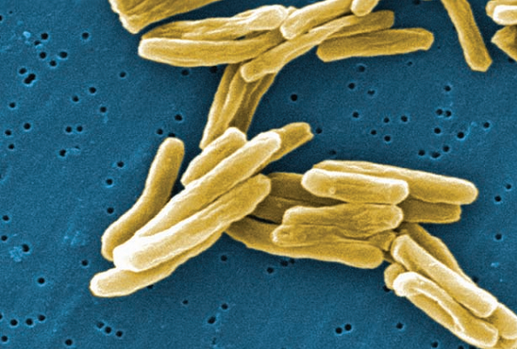
Pulmonary Tuberculosis
Tuberculosis is a chronic infection, potentially of lifelong duration, caused by two species of mycobacteria M. tuberculosis and, rarely, M. bovis.
It was isolated by Robert Koch in 1882.
The morbidity and mortality of tuberculosis are high in developing countries.
The disease is confined to the lungs in most patients but may spread to almost any part of the body.
The tubercle bacillus (M. Tuberculosis) is aerobic, non-motile, non-spore-forming, high in lipid content, and acid and alcohol-fast.
It grows slowly.
It can’t tolerate heat, but It can live in humid or dry or cold surroundings.

Slide 4
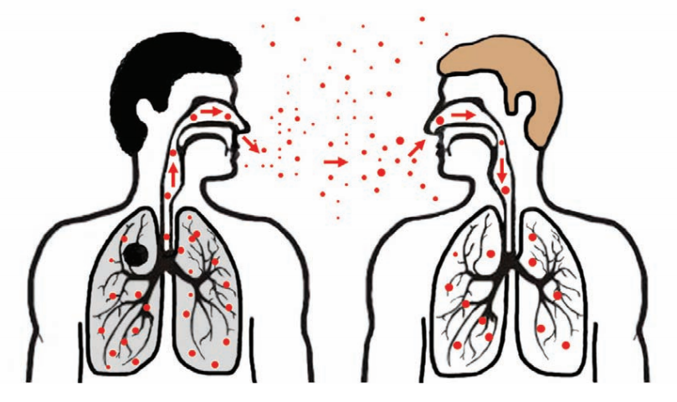
Modes of TB Transmission
Droplet infection: M. tuberculosis is carried in airborne particles, called droplet nuclei, of 1–5 microns in diameter. Infectious droplet nuclei are generated when persons who have pulmonary or laryngeal TB disease cough, sneeze, shout, or sing.
Food born infection.
Contact infection.
Intrauterine infection.

Slide 5
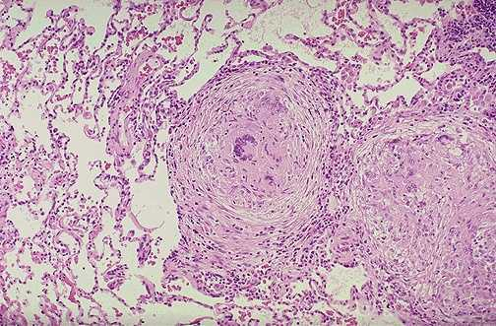

Pathogenesis of Pulmonary Tuberculosis
Bacterial entry
T Lymphocytes.
Macrophages.
Epithelioid cells.
Proliferation.
Central Necrosis.
Giant cell formation.
Fibrosis.

Slide 6

Pathogenesis of Pulmonary Tuberculosis
Primary tuberculosis
In a non immunized individual – children* adult*
Lesion in subpleural zone of lung – can be at other sites*
Brief acute inflammation – neutrophils.
5-6 days invoke granuloma formation.
2 to 8 weeks – healing – Ghon’s focus (+ lymph node → Ghon complex)
Develop immunity – Tuberculin skin test positive
Infection - Immunity

Slide 7
Pathogenesis of Pulmonary Tuberculosis
Primary Tuberculosis
In Non-Immunized individuals (Children)
Primary Tuberculosis:
Self Limited disease
Primary complex: Ghon’s focus, Lymphangitis and Lymphadenitis.
Primary Progressive TB:
Progression of primary complex components.
Miliary TB and TB Meningitis.
Common in malnourished children
10% of adults, Immuno-suppressed individuals

Slide 8
Pathogenesis of Pulmonary Tuberculosis
Secondary Tuberculosis:
Post Primary in immunized individuals.
Cavitary Granulomatous response.
Reactivation or Reinfection.
Apical lobes or upper part of lower lobes – O2
Caseation, cavity - soft granuloma.
Pulmonary or extra-pulmonary
Local or systemic spread / Miliary.
Vein – via left ventricle to whole body
Artery – miliary spread within the lung

Slide 9
Clinical Manifestations
Systemic symptoms:
Most cases of pulmonary tuberculosis present with fever, weight loss, anorexia, fatigue, night sweats.
Respiratory symptoms:
Cough may vary from mild to severe, and sputum may be scant and mucoid or copious and purulent
Hemoptysis may be due to cough of a caseous lesion or bronchial ulceration
Chest pain, tachypnea.
Physical signs: nonspecific.

Slide 10
Investigations
Radiology
Chest radiography is the most important method to detect TB
TB’s characteristics of a chest radiograph:
Shadows mainly in the upper zone
Patchy or nodular shadows
The presence of a cavity or cavities.
The presence of calcification.
Bilateral shadows, especially if these are in the upper zones.
The persistence of the abnormal shadows without alteration in an x-ray repeated after several weeks this helps to exclude a diagnosis of pneumonia or other acute infection.

Slide 11
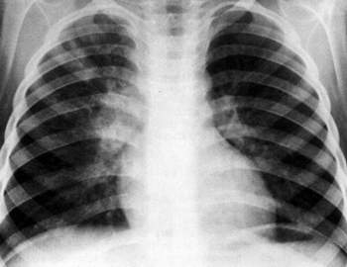
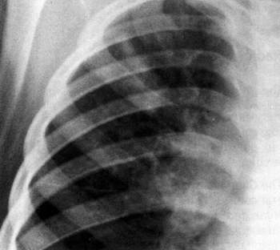
Investigations
Primary complex

Slide 12
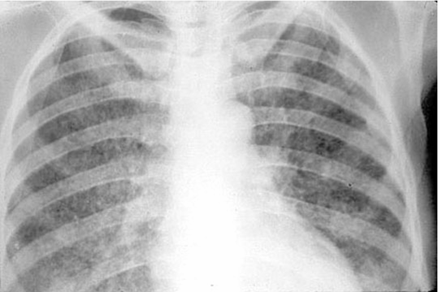
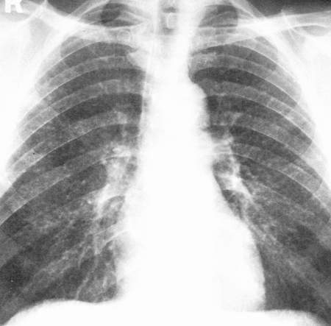
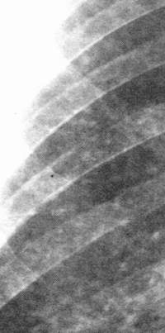
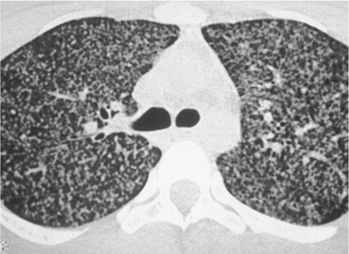
Investigations
Miliary Tuberculosis

Slide 13
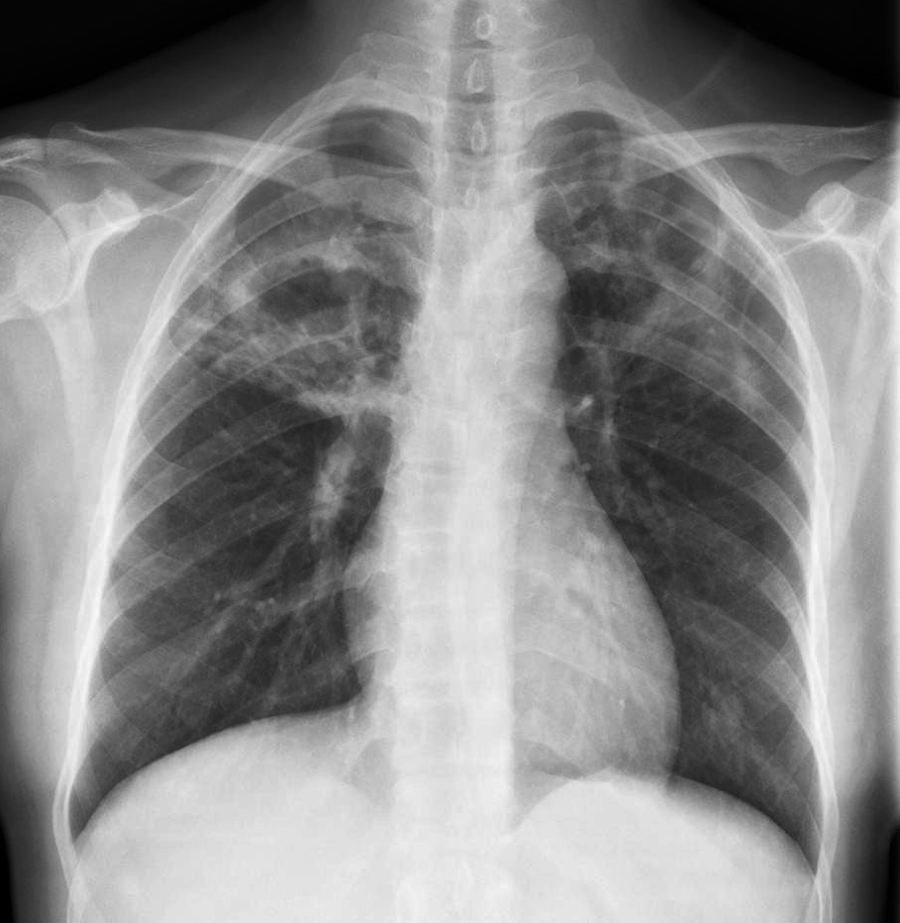
Investigations
Secondary pulmonary tuberculosis

Slide 14
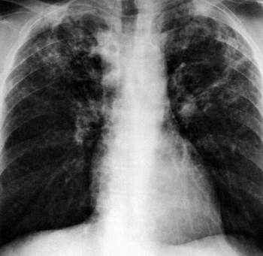
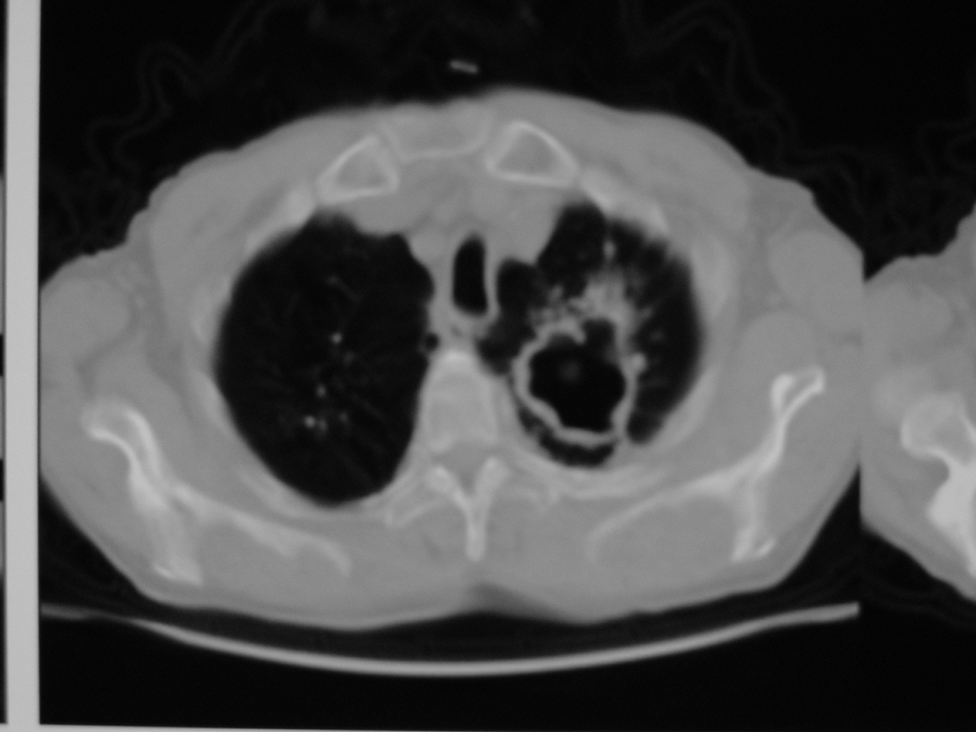
Investigations
Chronic fibro-cavitary pulmonary tuberculosis

Slide 15
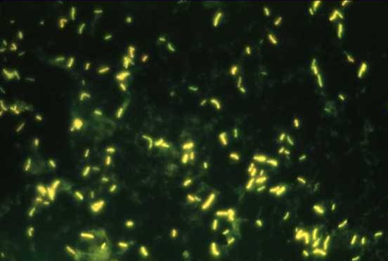
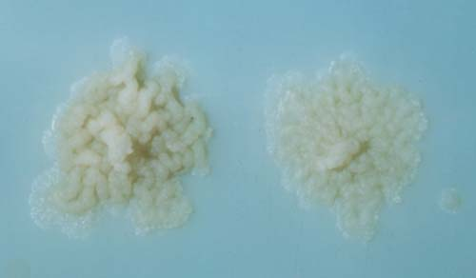
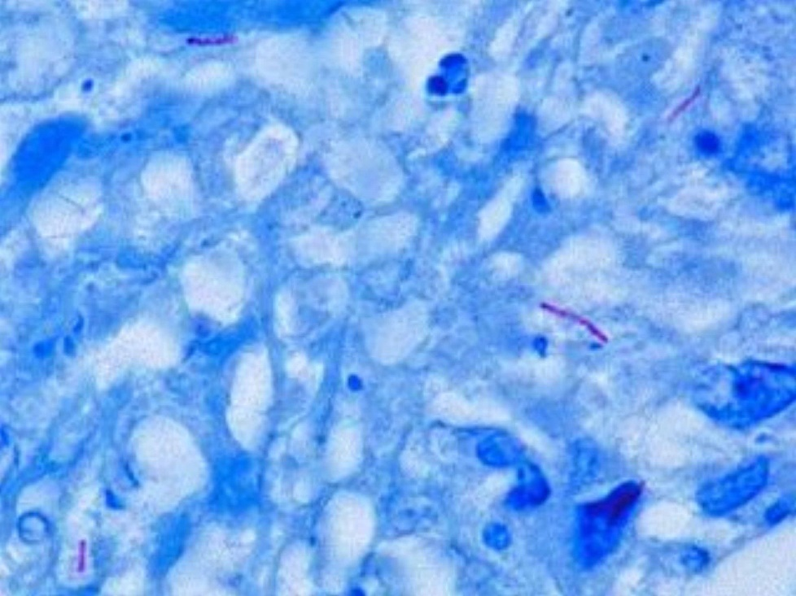
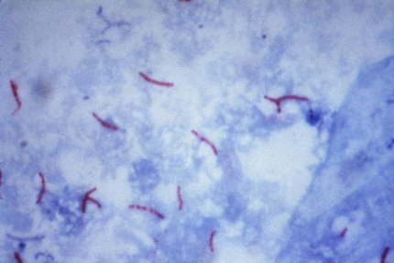
Investigations
Sputum examination:
There are direct smear and culture
Direct smear examination is only positive when large numbers of bacilli begin to be excreted

Slide 16
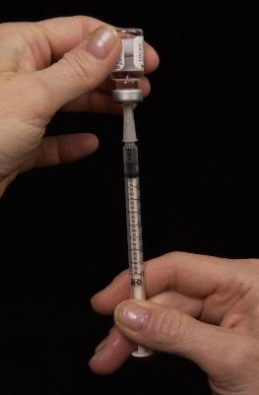
Mantoux Tuberculin Skin Test
Investigations
TST is administered by injection
Tuberculin is made from proteins derived from inactive tubercle bacilli (purified protein derivative)
Most people who have TB infection will have a reaction at injection site
Syringe being filled with 0.1 ml of liquid tuberculin
Notes:
16

Slide 17
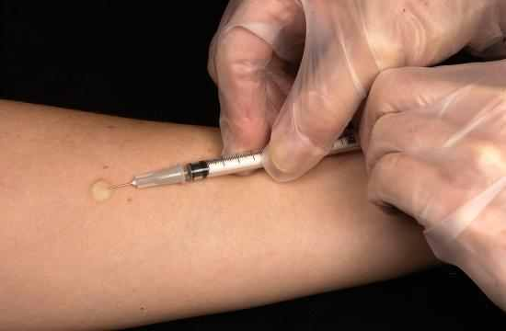
Investigations
Mantoux Tuberculin Skin Test
0.1 ml of 5 tuberculin units of liquid tuberculin are injected between the layers of skin on forearm
Notes:
17

Slide 18
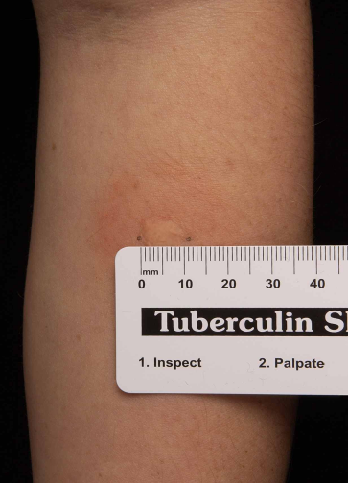
Investigations
Mantoux Tuberculin Skin Test
Forearm should be examined within 48 - 72 hours.
Reaction is an area of induration (swelling) around injection site
Induration is measured in millimeters.
Erythema (redness) is not measured.
Notes:
18

Slide 19
Investigations
Mantoux Tuberculin Skin Test
A reaction of less than 5 mm is considered negative
5-9 mm is considered positive (+)
10-19 mm is considered positive (++)
more than 20 mm is considered positive (+++)
A positive tuberculin skin test indicates tuberculous infection, with or without disease

Slide 20
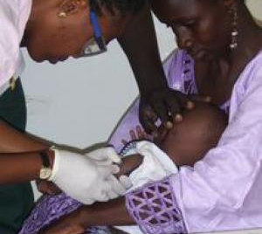
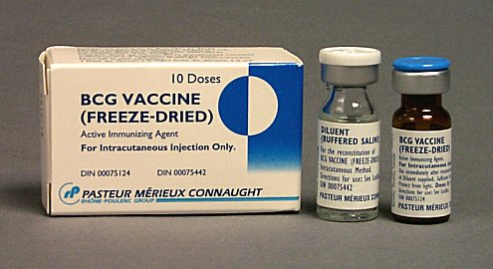
Treatment of Tuberculosis
Prophylaxis:
Case control.
Vaccination: (BCG):
Chemoprophylaxis:
Bacillus Calmette-Guérin = BCG
An “attenuated” strain of M tuberculosis that does not Cause disease but can stimulate the immune response
BCG is clearly effective against miliary TB and TB meningitis But its effectiveness against pulmonary TB is controversial

Slide 21
Treatment of Tuberculosis
Antituberculous Drugs
Medicines used to treat tuberculosis are classified as first-line and second-line agents
First-line essential antituberculous agents are the most effective and are necessary components of any short-course therapeutic regimen
First-Line Drugs
Second-Line Drugs
Isoniazid
Rifampicin
Pyrazinamide
Ethambutol
Cycloserine
p-Aminosalicylic acid
Ethionamide
Amikacin
Capreomycin
Levofloxacin
Moxifloxacin
Gatifloxacin
Streptomycin
Notes:
21

Slide 22
Treatment of Tuberculosis
Treatment Regimen:
Initial phase: standard four drug regimens (Isoniazid, Rifampicin, Pyrazinamide, Ethambutol) for 2 months.
Continuation phase: additional 4 months or (7 months for some patients) with Isoniazid and Rifampicin.
Treatment Monitoring

Slide 23
Treatment of Tuberculosis
Isoniazid (INH)
Dose: 5mg/kg/day (300mg) orally
Side effects:
Hepatotoxicity
Peripheral neuritis
Rifampicin (RIF)
Dose: 10mg/kg/day (600mg) orally
Side effects:
Hepatotoxicity
GIT irritation, nausea, vomiting, diarrhea.
Red discoloration of urine

Slide 24
Treatment of Tuberculosis
Ethambutol (EMB)
Dose: 15 – 20 mg/kg/day (1600mg) orally
Side effects:
Optic neuritis
Pyrazinamide (PZA)
Dose: 20 – 30 mg/kg/day (2000mg) orally
Side effects:
Hepatotoxicity
Hyperuricemia
Arthralgia

Slide 25
Latent TB
The presence of live, dormant (not reproducing) Mycobacterium tuberculosis organisms.
The term latent indicates that the infection is not clinically apparent.
Can't spread from person to person.
Can advance to TB disease.
Diagnosis of latent T.B:
CXR is normal or have only trivial and stable evidence of past T.B (e.g., a small scar or patch of calcium).
Positive TST.
Negative sputum test.

Slide 26
Latent TB treatment
The WHO recommends two regimens:
3 or 4 months of isoniazid plus rifampicin daily.
Or
6 months of isoniazid daily.

Slide 27
Thank You

